Slide 1

M
E
M
O
R
Y
BY:MS.AQSA FAYYAZ
LECTURER
(SCIENCE AND HUMANITIES)

Slide 2

Memory
“Memory refers to our capacity to acquire ,store and retrieve the information. It is a process of maintaining information over time.” (Matlin, 2005). Memory’ is a label for a diverse set of cognitive capacities by which humans and perhaps other animals retain information and reconstruct past experiences, usually for present purposes.”
Notes:
https://www.simplypsychology.org/memory.html

Slide 3
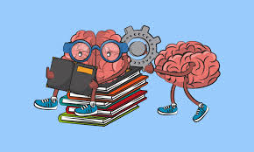
Why memory is important?
Memory is essential to all our lives. Without a memory of the past, we cannot operate in the present or think about the future.
We would not be able to remember what we did yesterday, what we have done today or what we plan to do tomorrow.
Without memory, we could not learn anything.
Notes:
https://www.simplypsychology.org/memory.html

Slide 4
Human Memory is Good at..
Information on which attention is focused
Information in which we are interested
Information that arouses us emotionally
Information that fits with our previous experiences
Information that we rehearse

Slide 5
BUT…
“The paradox of memory , it can last your life time or be gone tomorrow, you can be unable to remember something you want to recall or incapable of ignoring what you would like to forget”

Slide 6

Seven sins of memory by Daniel Schacters
Memories are transient (Fades with time)
We do not remember what we do not pay attention to (absent mindedness)
Our memories can be temporarily blocked
We can misattribute the source of memory
We are suggestible in our memory
We can show memory distortion (Bias)
We often fail to forget the things we would like not to recall (persistence of memory)

Slide 7

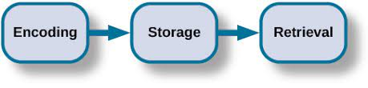
Putting in memory
Maintain in memory
Recover from memory

Slide 8

1. Encoding
Encoding: The registration (receiving, processing and combining of received information)
WAYS OF ENCODING:
There are three main ways in which information can be encoded: 1. Visual (picture) 2. Acoustic (sound)
3. Semantic (meaning)

Slide 9
2. Storage
Involves retention of encoded material over time
what kind of information is held.
3. Retrieval
Occurs when the fact/ information is recovered from storage
Example: when we take an exam
Involves the location and recovery of information from memory

Slide 10
Stages of Memory
Sensory
Memory
Short term
Memory
Long term memory
Memory

Slide 11
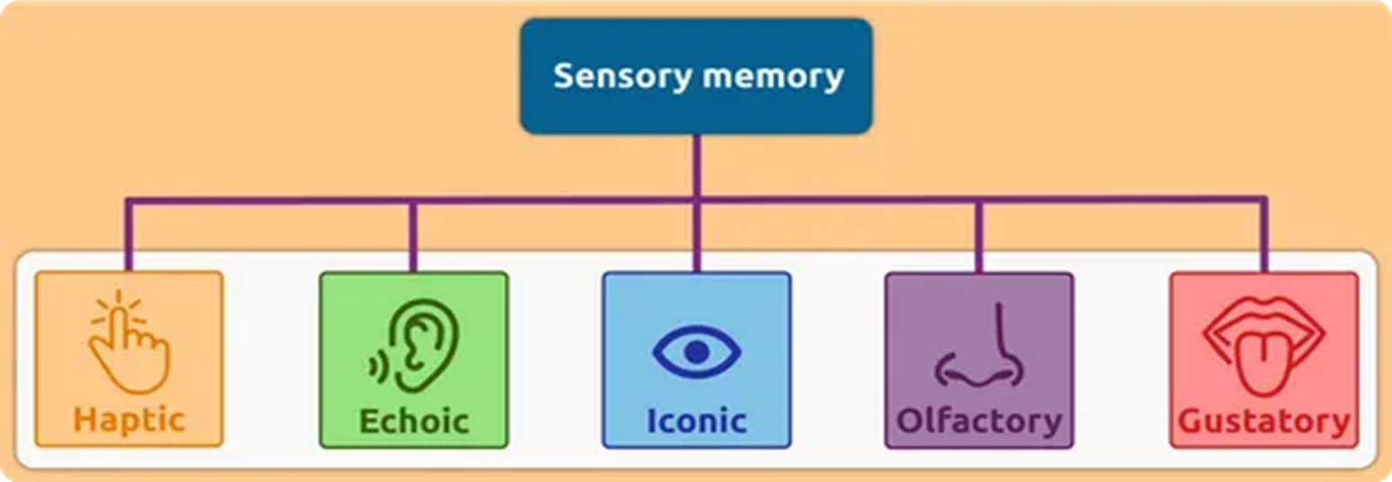
Stage 1: Sensory memory
It is the first stage of memory, takes place through the process of encoding.
The ability to look at an item, and remember what it looked like with just a second of observation, or memorization, is an example of sensory memory.
Your sensory memory creates something of a quick "snapshot" of the world around you, allowing you to briefly focus your attention on relevant details.
By attending to this information, we can then transfer important details into the next stage of memory, which is known as short-term memory.

Slide 12
Cont.
Duration
millisecond
Capacity
all sensory experience (limited capacity)
Encoding
sense specific (e.g. different stores for each sense)
Information is going to nervous system through your sense organs

Slide 13
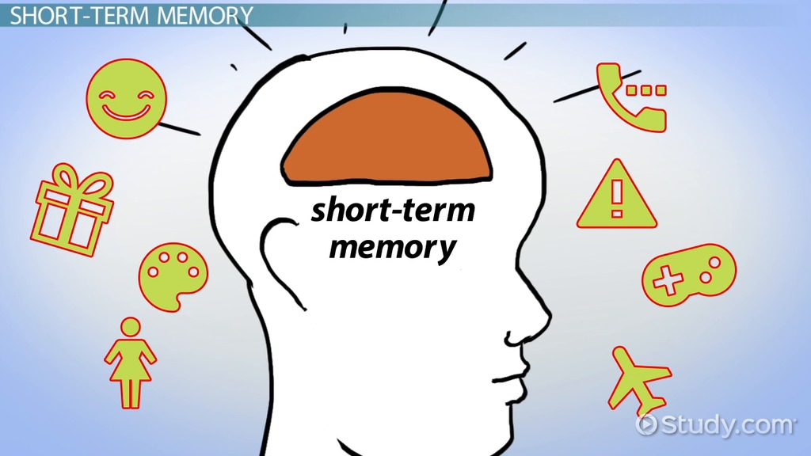
Stage 2: Short Term Memory
The stuff we encode from the sensory goes to STM.
This stage of memory lasts for a short amount of time, generally less than a minute (between 15 and 30 seconds).

Slide 14
Cont.
Short term memory is also called working memory.
The memory system in which information is held for brief periods of time while being used.
In an influential paper titled "The Magical Number Seven, Plus or Minus Two," psychologist George Miller (1965) suggested that people can store between five and nine items in short-term memory.
Limited capacity = 7±2 items
STM is susceptible to interference e.g., if counting is interrupted, have to start over.
We recall digits better than letters.

Slide 15
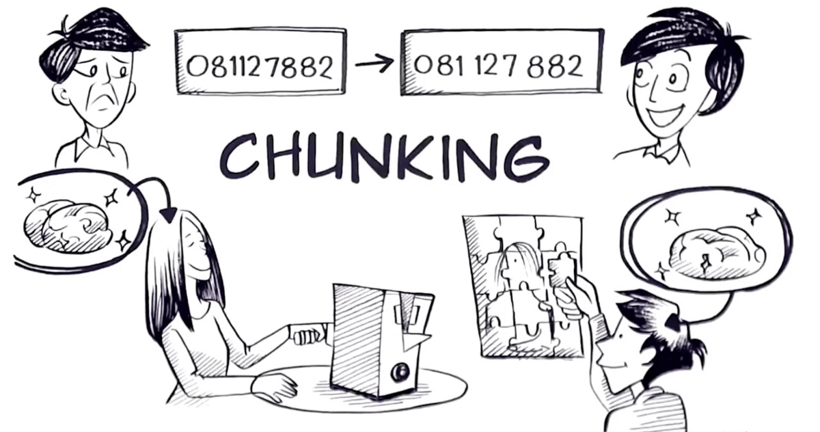
Encoding & Storage in Working Memory
Chunking
Organizing pieces of information into a smaller number of meaningful units.
Chunking allows people to take smaller bits of information and combine them into more meaningful, and therefore more memorable, wholes.
For example, a phone number sequence of 4-7-1-1-3-9-2 would be chunked into 471-1392.

Slide 16
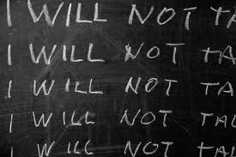
Maintenance rehearsal
Process in which information is repeated or reviewed to keep it from fading while in working memory.
For example: repeating a phone number mentally, or aloud until the number is entered into the phone to make the call.
Without rehearsing or continuing to repeat the number until it is committed to memory, the information is quickly lost from short-term memory.

Slide 17
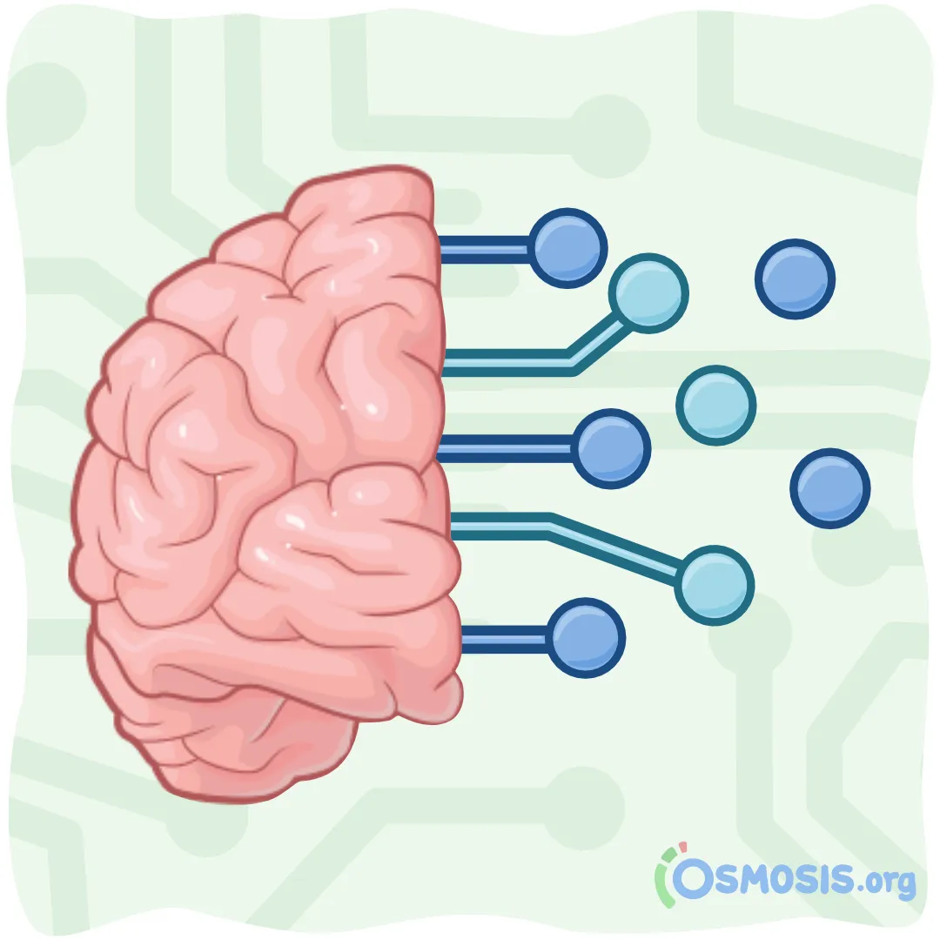
Elaborative rehearsal
A strategy to facilitate the formation of memory by linking new information to what one already knows.
By making associations between the new information you're trying to learn and the information you already know, you're making your brain process the information in a more in-depth way.
For example: imagine meeting someone whose name is Sandy, then making an association with a sandy beach to remember that name.

Slide 18
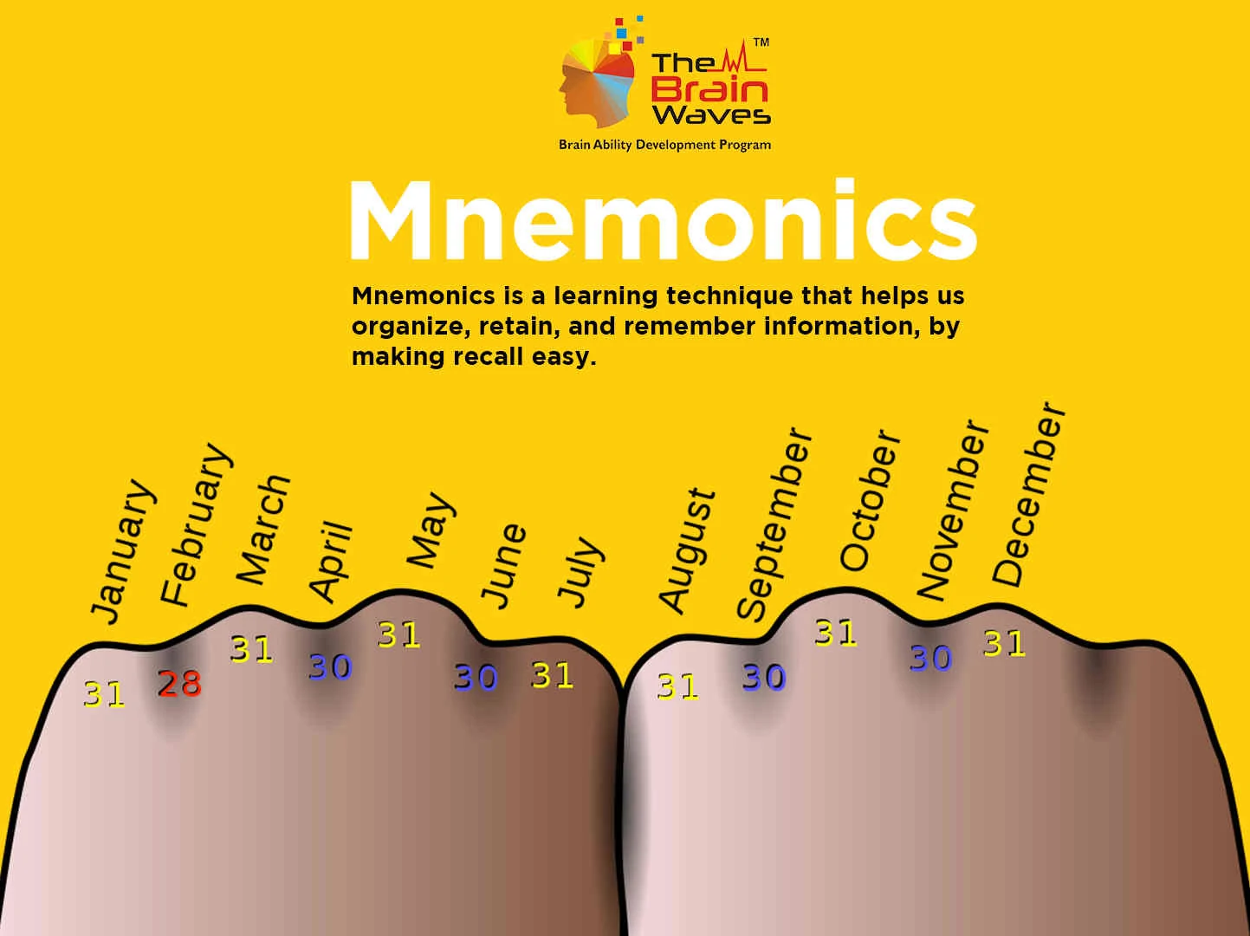
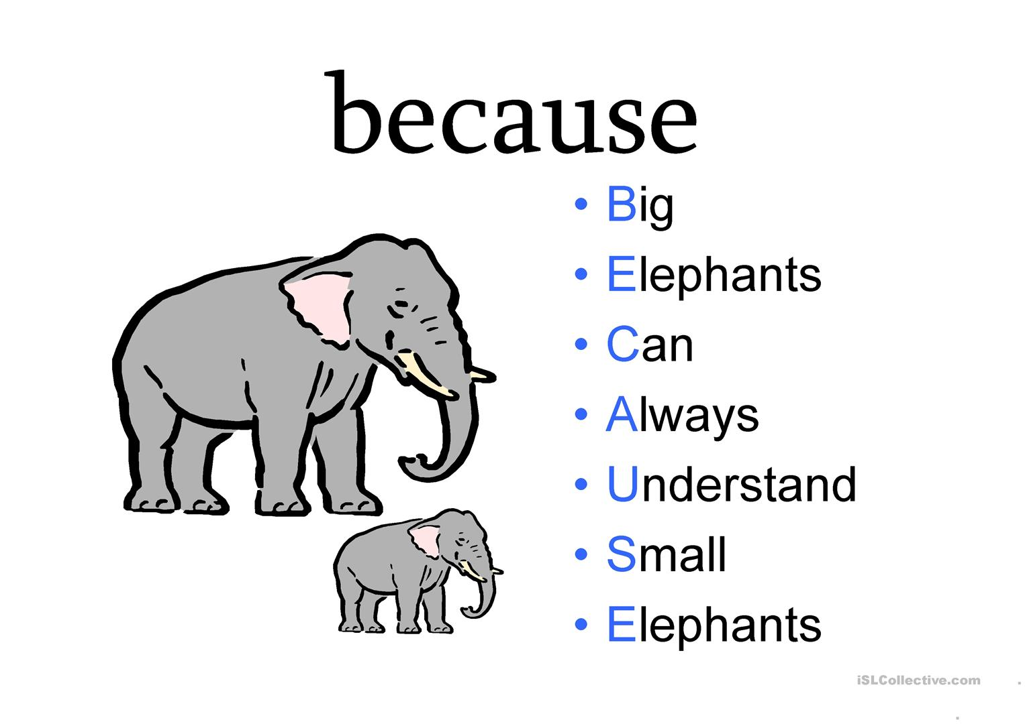
Memory Strategies: To get from STM to LTM
Mnemonics are the techniques in which new information is associated with something familiar and previously encoded”

Slide 19

Why are we good at remembering faces, but not names???
Have you ever walked to a nearby store and come back without even thinking about the route????

Slide 20
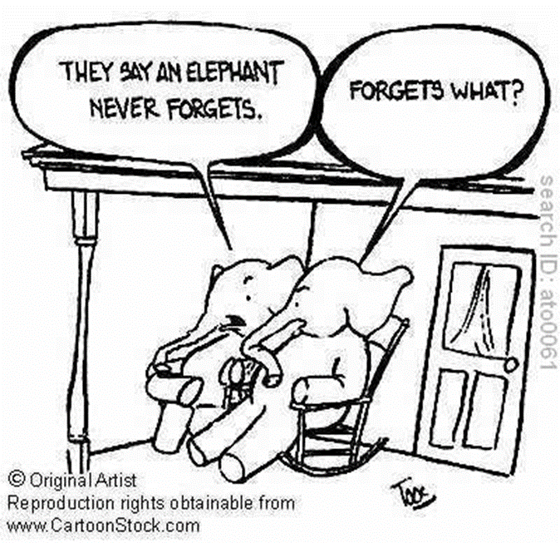
Stage 3: Long term Memory (LTM)
Unlimited storehouse of information
The system of memory into which all the information is placed to be kept more or less permanently.
Duration
Unlimited
Capacity
Unlimited

Slide 21
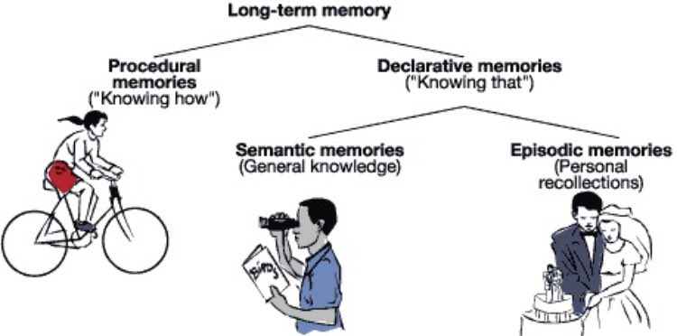

Slide 22
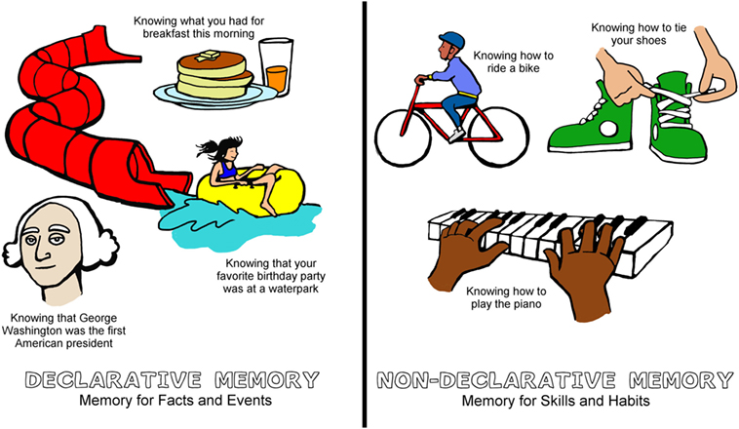
Types of Long Term Memory(LTM):
1. Procedural memory (IMPLICIT UNCONCIOUS)
A type of long term memory that stores memories for how things are done.
are habitual in nature.
Memories for the performance of actions or skills (i.e., procedural memories, “knowing how”)
Example: Riding a bike, tying your shoes, and Writing with a pen are all examples of procedural memories.

Slide 23
II. Declarative memory (EXPLICIT CONCIOUS)
Require a more conscious effort to recall
Division of LTM that stores explicit information (also known as fact memory)
Memories of facts, rules, concepts, and events (i.e., declarative memories, “knowing that”).
Example: London is the capital of England, zebras are animals, and the date of your mum's birthday

Slide 24
Types of Declarative memory
Episodic memory (specific event)
Subdivision of declarative memory that stores memories for personal events, or “episodes”
Memories of autobiographical events, situations, and experiences.
Example: remembering you 5th birthday party.
Semantic memory (Fact based but meaning associated)
stores general knowledge, including meanings of words and concepts unrelated to specific experiences.
Example: you know what a dog is and can read the word 'dog' and be aware of the meaning of this concept

Slide 25
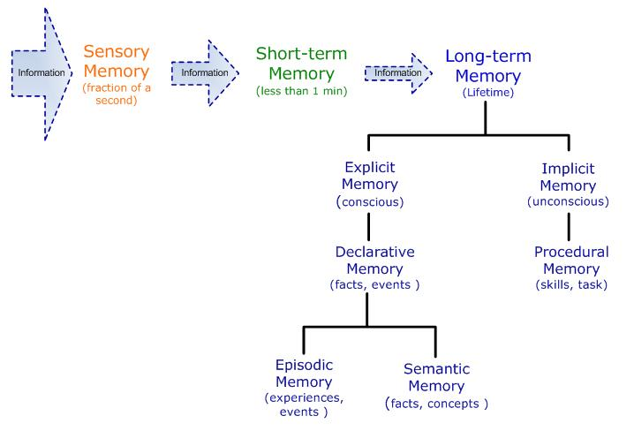

Slide 26
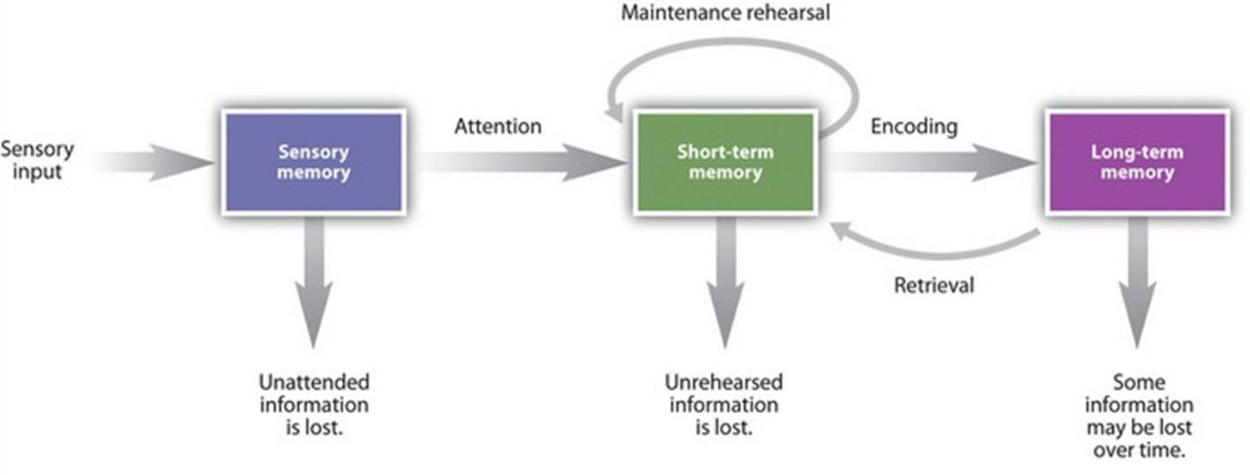
Traditional Model of Memory
 Atkinson & Shiffrin (1968) 3 Stage Model

Slide 27
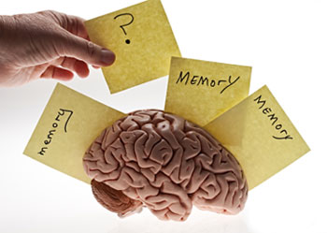
ACTIVITY

Slide 28
Here are the words in the order viewed
BED
CLOCK
DREAM
NIGHT
TURN
MATTRESS
SNOOZE
NOD
TIRED
NIGHT
ARTICHOKE
INSOMNIA
REST
TOSS
NIGHT
ALARM
NAP
SNORE
PILLOW

Slide 29
Here are the words in the order viewed
Did you recall? Explanation
Bed? Clock? Primacy Effect Snore? Pillow? Recency Effect
BED
CLOCK
DREAM
NIGHT
TURN
MATTRESS
SNOOZE
NOD
TIRED
NIGHT
ARTICHOKE
INSOMNIA
REST
TOSS
NIGHT
ALARM
NAP
SNORE
PILLOW
Night? Artichoke?
Toss? Toss & Turn?
Sleep?
Spacing Effect Distinctiveness
Clustering
False Memory

Slide 30
Serial Position Effect
Primacy effect – remembering stuff at beginning of list better than middle
Recency Effect – remembering stuff at the end of list better than middle because of lack of Interference

Slide 31
Methods in Study of Memory
Which type of memory test would you rather have?
An essay or a multiple choice exam?
The difference between these two types of tests captures the difference between a recall task and a recognition test

Slide 32

Recall Tasks
Free Recall
Recall all the words you can from a list you saw previously
Cued Recall
Recall everything you can that is associated with Ivan Pavlov in Psychology
Participants are given a cue to facilitate recall
Serial Recall
Recall the names of all previous prime ministers in the order they were elected
Need to recall order as well as item names

Slide 33
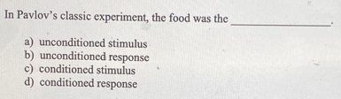
Recognition Tasks
Recognition, in psychology, a form of remembering characterized by a feeling of familiarity when something previously experienced is again encountered.
Example: Most students would rather take a multiple-choice test, which utilizes recognition memory.

Slide 34
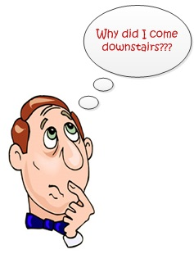

Causes of Retrieval Failure
Interference: The phenomenon by which information in memory disrupts the recall of other information i.e., retroactive & proactive interference
Anxiety: During exam, students were unable to recall a specific name or date and recalled it just after the exam.
Poor psychological / physical state: Depression, anxiety, poor concentration, headache, stress etc.
Age Factor: Dementia
Decay:
Non use of information for a longer period of time

Slide 35

Forgetting
“Forgetting refers to the loss of information that was previously stored in memory”

Slide 36
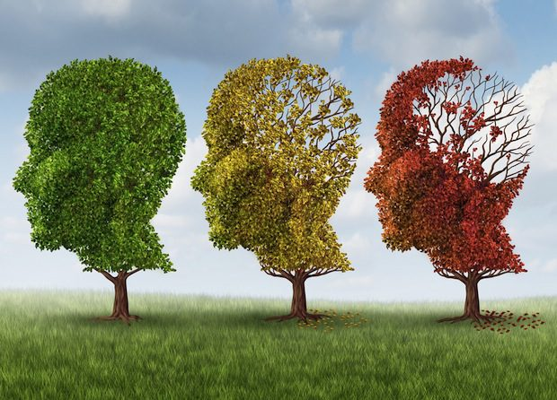
Forgetting
Loss or failure to recall information stored in human memory

Slide 37
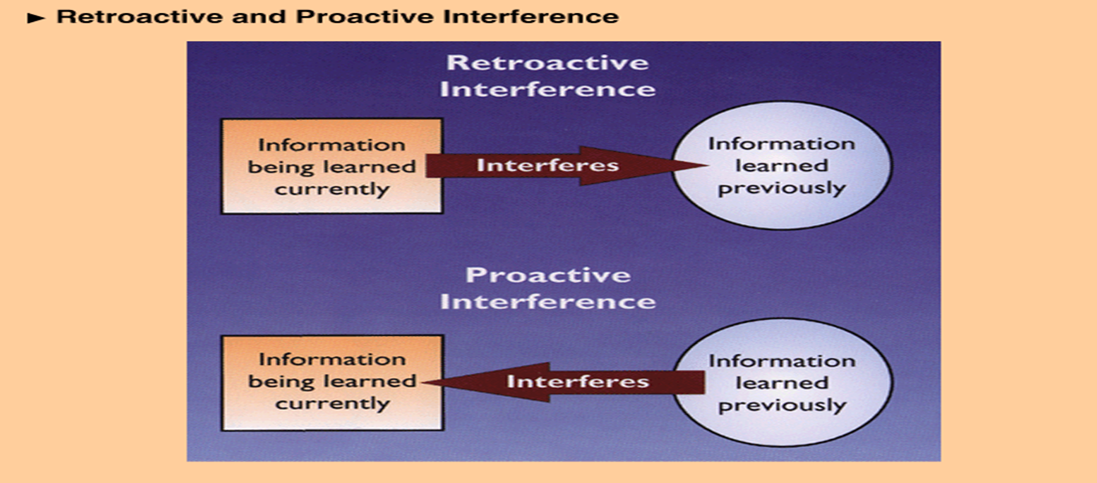
Forgetting Is a Process, Too!
Proactive interference:
Old information interferes with recall of new information
i.e. Call new friend with the old friend’s name
Retroactive interference:
new information interferes with recall of old information
i.e. Forgetting old car number as soon as you get new car

Slide 38
Cont.
Decay theory (Fading theory):
memory trace fades with time
Motivated forgetting:
Involves the loss of painful memories (protective memory loss)
Retrieval failure:
The information is still within LTM, but cannot be recalled because the retrieval cue is absent

Slide 39
Other reasons for forgetfulness
Alcohol
Anxiety and Stress
Depression
Any other Mental Health Problem
Physical Injury or Trauma to brain
Organic Causes: Alzheimer, Dementia and Amnesia
Notes:
https://thepeakperformancecenter.com/educational-learning/learning/memory/forgetting/

Slide 40

Ways
of
improving
your Memory

Slide 41

Ways of improving memory
1.Avoid cramming by establishing regular
study sessions.
According to Bjork (2001), studying materials over a number of session's gives you the time you need to adequately process the information.
Research has shown that students who study regularly remember the material far better than those who did all of their studying in one marathon session.

Slide 42

Ways of improving memory
2. Structure and organize the information you are studying.
Researchers have found that information is organized in memory in related clusters. You can take advantage of this by structuring and organizing the materials you are studying.
Try grouping similar concepts and terms together, or make an outline of your notes and textbook readings to help group related concepts.

Slide 43
Ways of improving memory
3. Utilize Mnemonic devices to remember information
Mnemonic devices are a technique often used by students to aid in recall. A mnemonic is simply a way to remember information.
For example, you might associate a term you need to remember with a common item that you are familiar with.
The best mnemonics are those that utilize positive imagery, humor or novelty. You might come up with a rhyme, song or joke to help remember a specific segment of information.
“Roy G. Biv” for the colors of the rainbow (red, orange, yellow, green, blue, indigo, violet)

Slide 44

Ways of improving memory
4. Elaborate and Rehearse the Information are studying.
In order to recall information, you need to encode what you are studying into long-term memory. One of the most effective encoding techniques is known as elaborative rehearsal.
An example of this technique would be to read the definition of a key term, study the definition of that term and then read a more detailed description of what that term means. After repeating this process a few times, your recall of the information will be far better.

Slide 45

Ways of improving memory
5. Teach new concepts to another person
Research suggests that reading materials out loud significantly improves memory of the material. Educators and psychologists have also discovered that having students actually teach new concepts
to others enhances understanding and recall.
You can use this approach in your own studies
by teaching new concepts and information to
a friend or study partner.

Slide 46
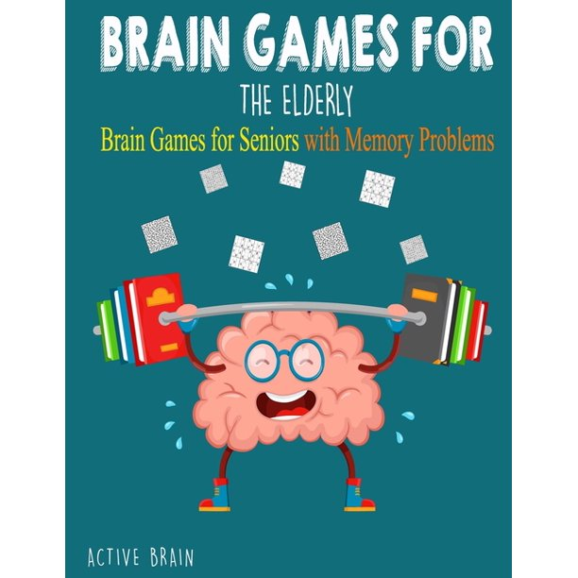

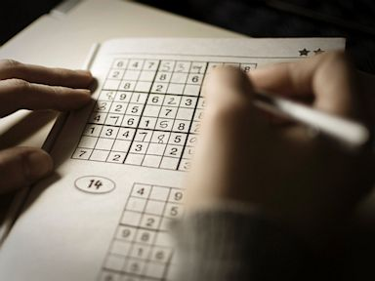
Ways of improving memory
6. Play brain games:
Your brain is a muscle that needs exercise just like other parts of your body. Puzzles and logic games challenge your brain to think and make connections.
Memory games challenge the mind and help the gray matter in our brains—the part that impacts memory—to grow and expand.

Slide 47


